Slide 1
Junior Historians

Slide 2
What is Junior Historians?
History centered club
Host annual Veteran’s Dinner to celebrate local veterans in November
Host annual Senior Citizen’s Dinner in May
Participate in different kinds of volunteering

Slide 3
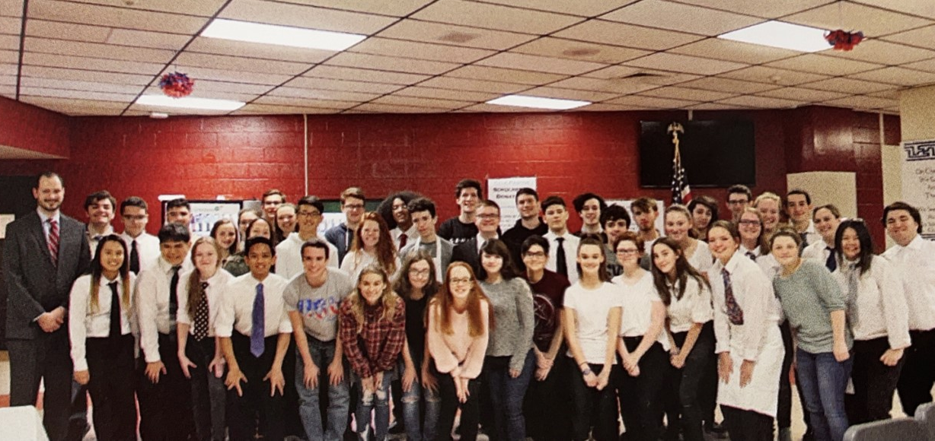
Annual Veteran’s Day Dinner celebrating veterans

Slide 4
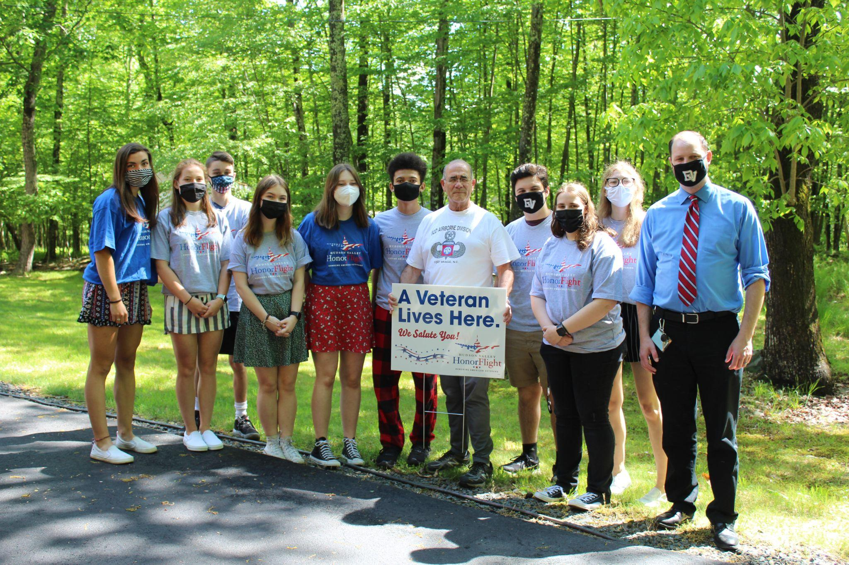
Members delivered signs to local veterans for Memorial Day

Slide 5
9/11 Memorial Mural
Plan to paint a 9/11 memorial mural in the school
Commemorate 20th anniversary

Slide 6
Volunteer Hours
All volunteer hours can be used for other clubs like NHS, FBLA, etc.
Looks great on college applications!

